Slide 1





















SwarmGenomics Downloading a genome and preprocessing
ATGCTTCGCGAACGTACGTCGCGAACATTATGCTTCGCGAACGTACGTACGTAGGT

Slide 2
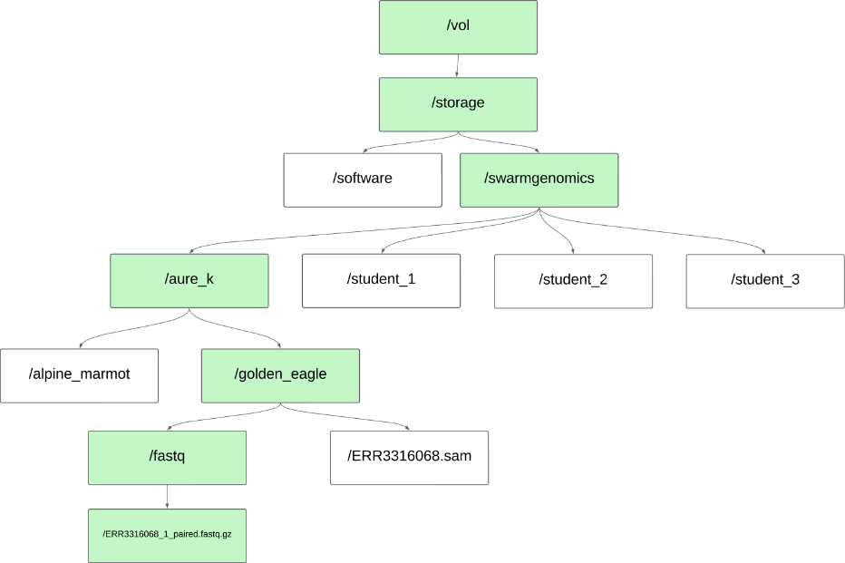
Working directory = /vol/storage/swarmgenomics/aure_k

Slide 3
Useful Bash commands
Command | Description | Example
pwd | Print current working directory | pwd → /Users/yourname/Projects
ls | List files and folders | ls -l (detailed list), ls -lh (show file info)
cd | Change directory | cd Documents/
mkdir | Make a new directory | mkdir new_folder
touch | Create a new empty file | touch file.txt
cp | Copy files or directories | cp file.txt backup.txt
mv | Move or rename files/folders | mv old.txt new.txt
rm | Remove files | rm file.txt
rm -r | Remove directories and contents | rm -r folder/
cat | View contents of a file | cat file.txt
vim | Edit files in terminal | vim file.txt
echo | Print text to terminal | echo "Hello"
chmod | Change file permissions | chmod +x script.sh
grep | Search inside files | grep "text" file.txt
htop | View running processes | htop

Slide 4
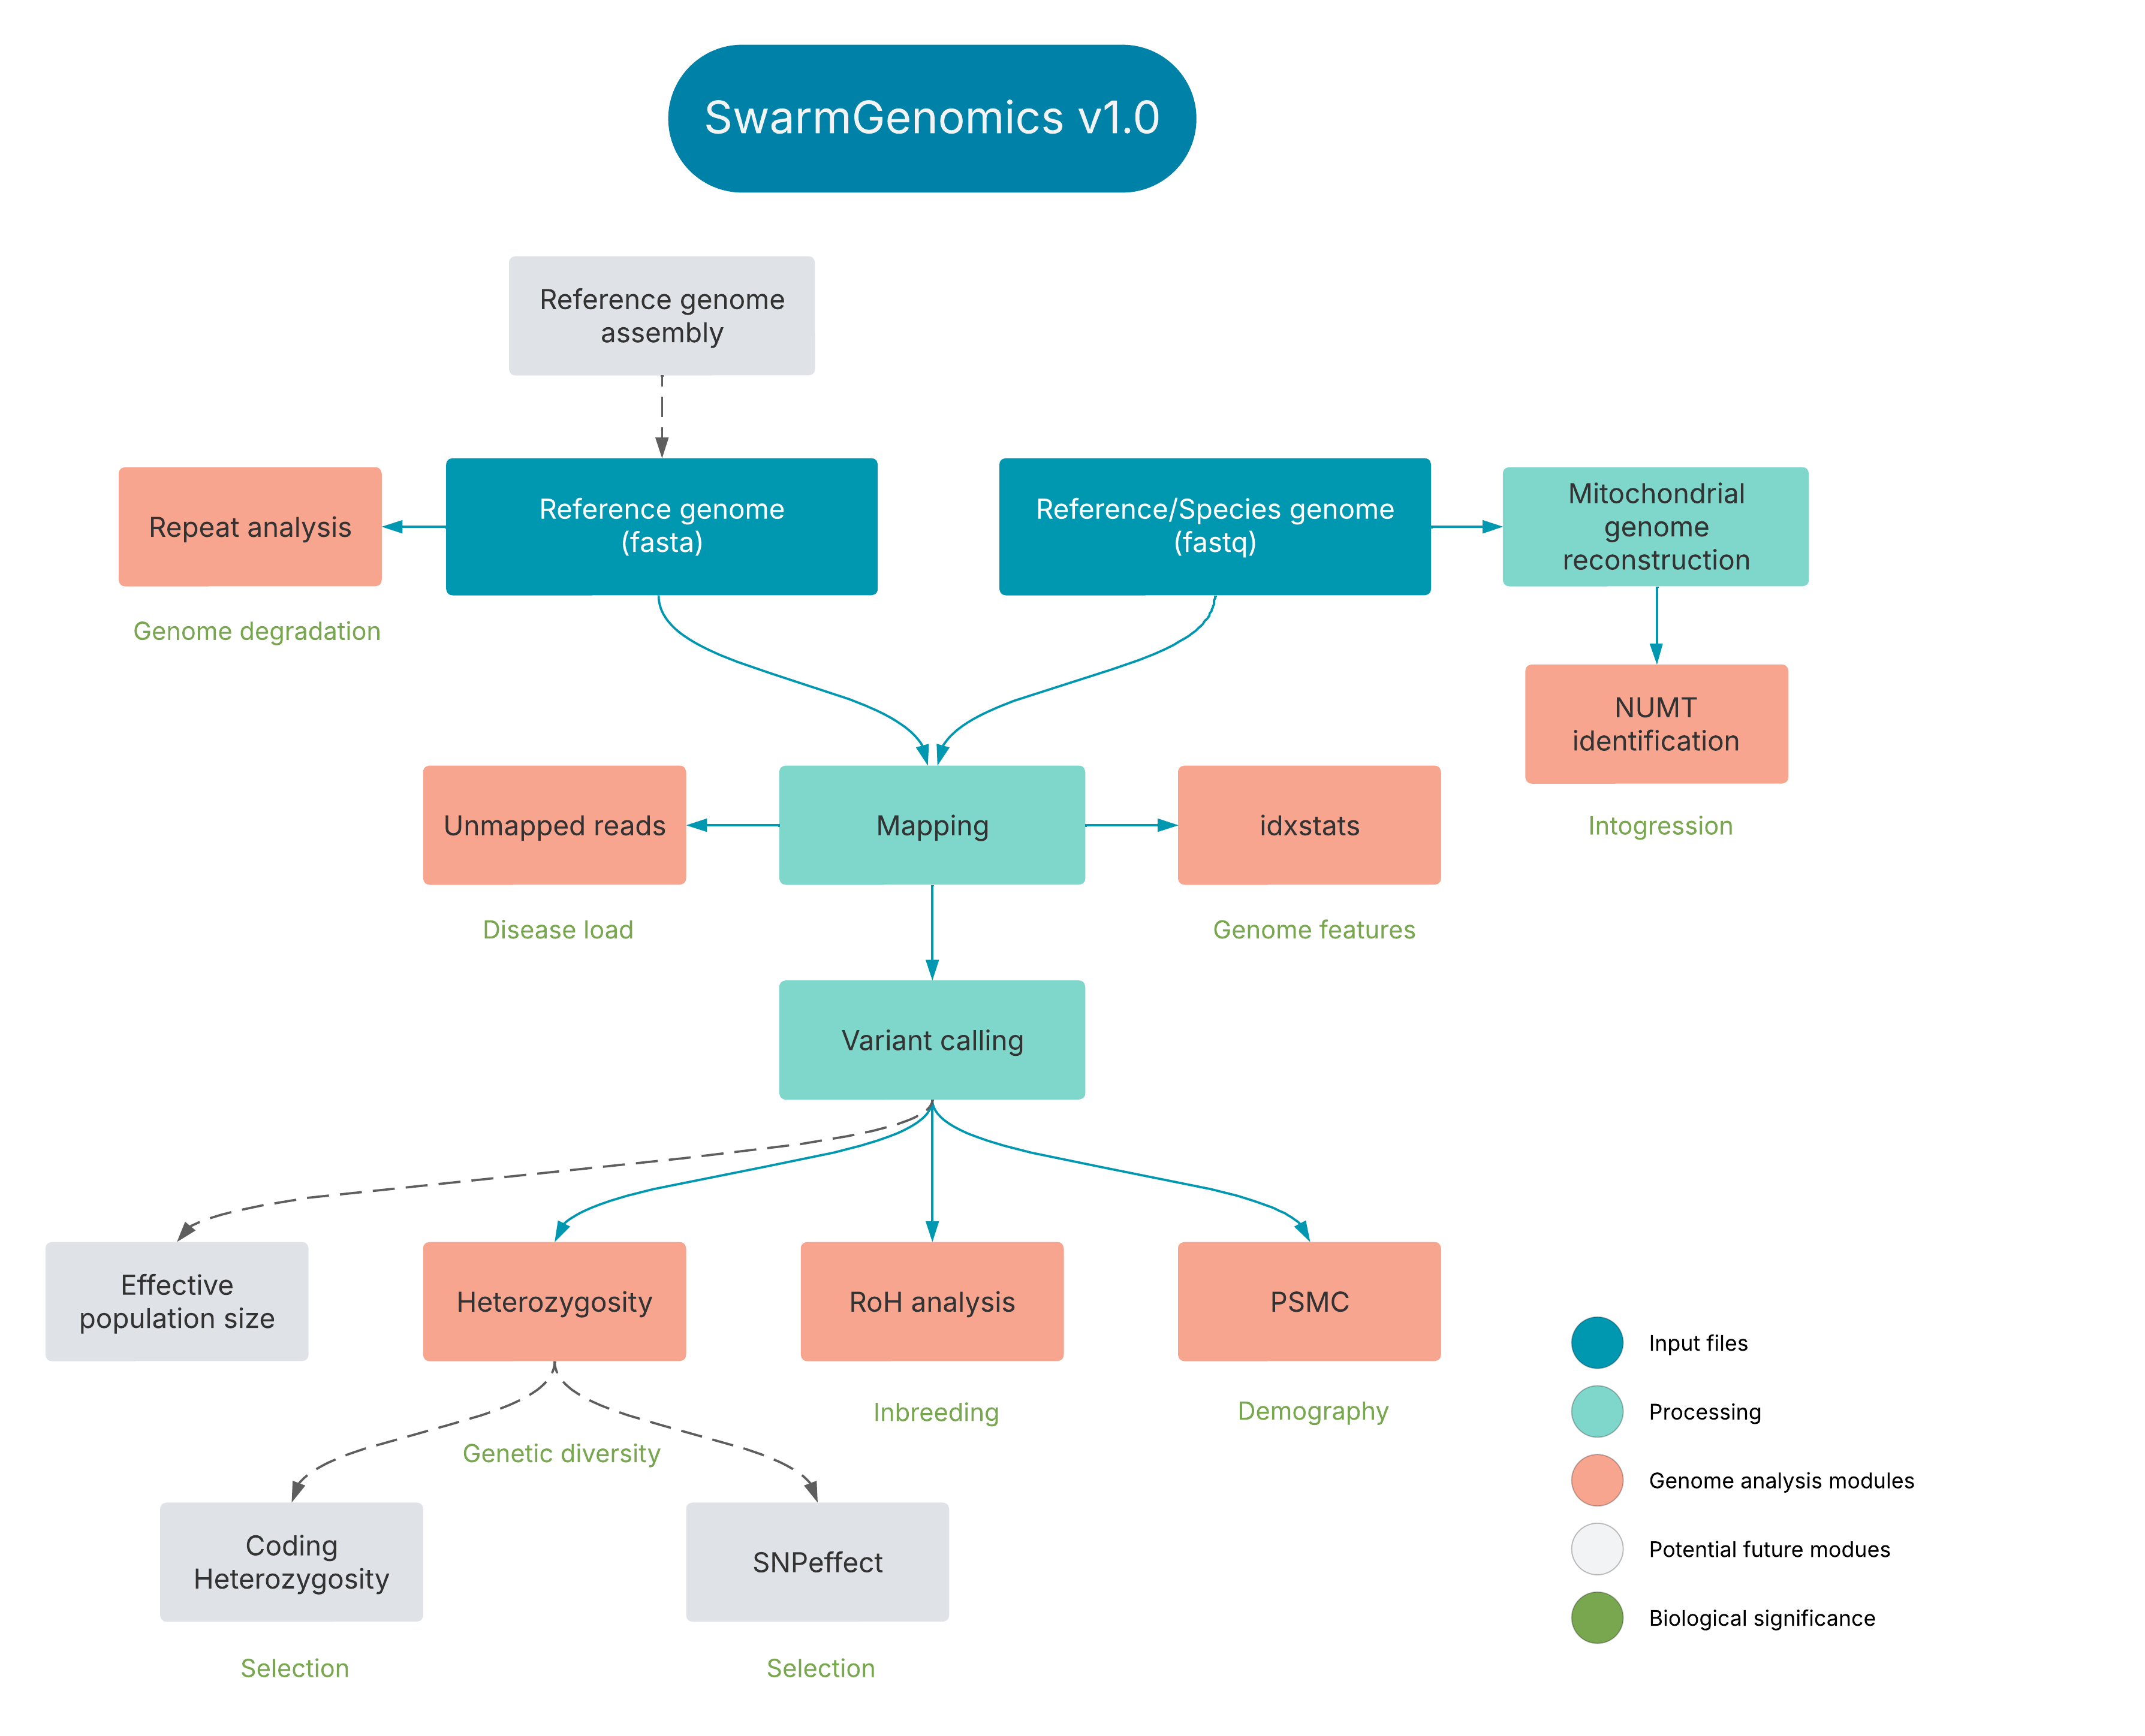

Slide 5
All instructions on GitHub
https://github.com/AureKylmanen/Swarmgenomics
Instructions on how to install required software: 0. Installations
Otherwise: 01. Getting Started

Slide 6
Make a directory for yourself and your species
Start by changing into your working directory
cd /vol/storage/swarmgenomics/your_name
Make a directory for your species
mkdir species_name

Slide 7
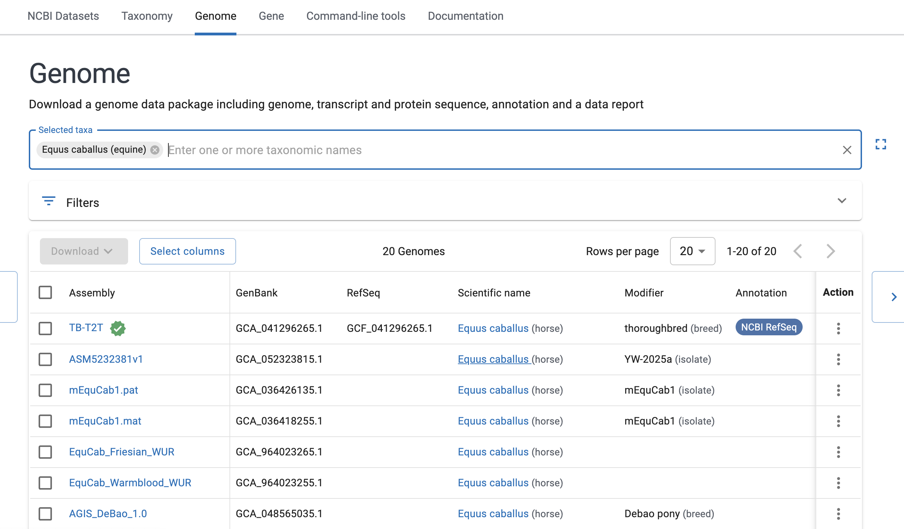
Selecting a Reference Genome
https://www.ncbi.nlm.nih.gov/datasets/genome/​
​
Search for a species of your interest
Look for:
Green badge → indicates the official Reference Genome.
RefSeq assemblies → preferred over GenBank, as they are curated and standardized by NCBI.
Chromosome-level assemblies → if available, these are higher quality than scaffold- or contig-level assemblies.
If multiple options exist, choose the most recent and well-annotated RefSeq assembly at chromosome level (if possible).

Slide 8
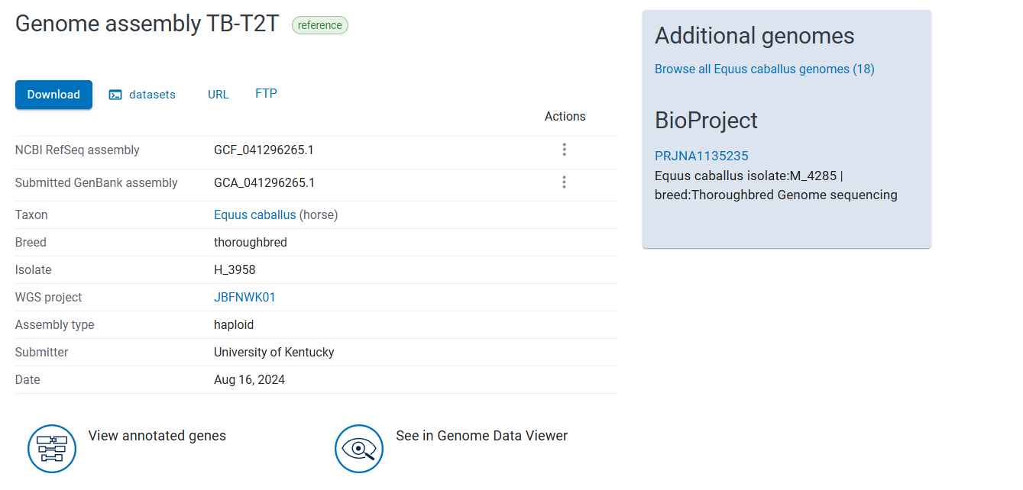
Downloading a genome

Slide 9
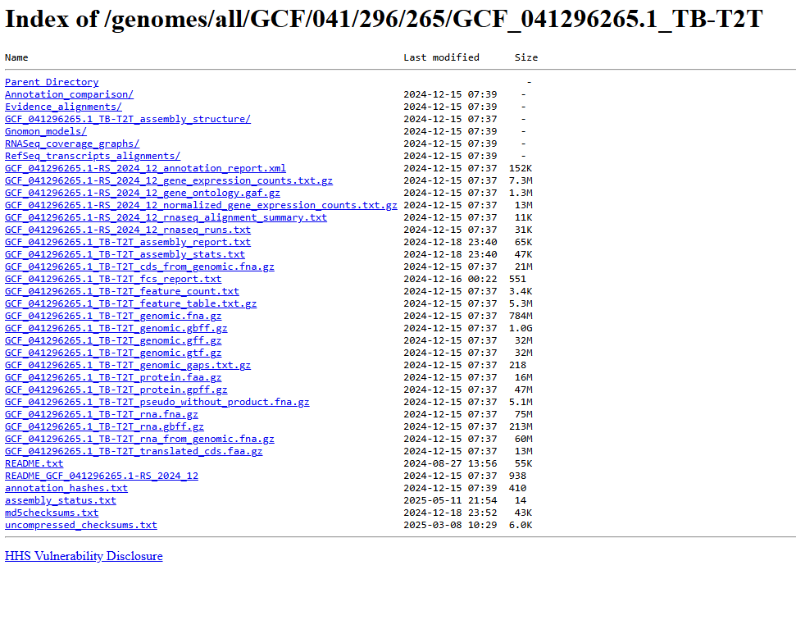
Right click the file that ends with _genomic.fna.gz to copy the link address e.g.
https://ftp.ncbi.nlm.nih.gov/genomes/all/GCF/041/296/265/GCF_041296265.1_TB-T2T/GCF_041296265.1_TB-T2T_genomic.fna.gz
Not cds_from_genomic.fna.gz

Slide 10
Downloading the reference genome
Change to your directory
cd /vol/storage/swarmgenomics/your_name/your_species
Download reference genome
wget https://ftp.ncbi.nlm.nih.gov/genomes/all/GCF/900/496/995/GCF_900496995.4_bAquChr1.4/GCF_900496995.4_bAquChr1.4_genomic.fna.gz
This will GCF_900496995.4_bAquChr1.4_genomic.fna.gz in your directory (example)
Link to the reference genome

Slide 11
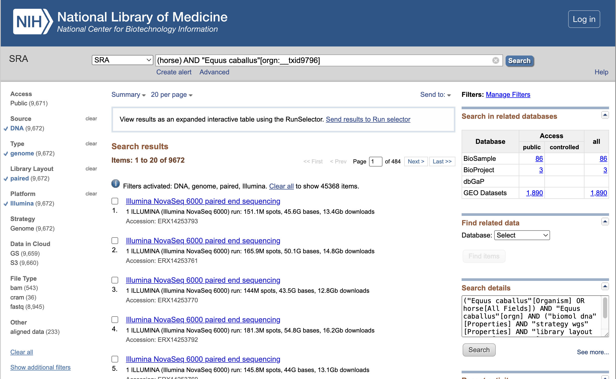
Selecting the SRA file (raw sequencing reads)
Go to https://www.ncbi.nlm.nih.gov/sra and search for your species
Filter the results:
Type: genome
Library Layout: paired
Platform: Illumina
Avoid metagenomics data
Also look into the BioSample data to get infromation on:
Location (Geographical information, but also if a wild or zoo sample)
Tissue (blood and muscle etc.)
Sex
Choose a large file (more reads) to ensure high coverage for more reliable results

Slide 12
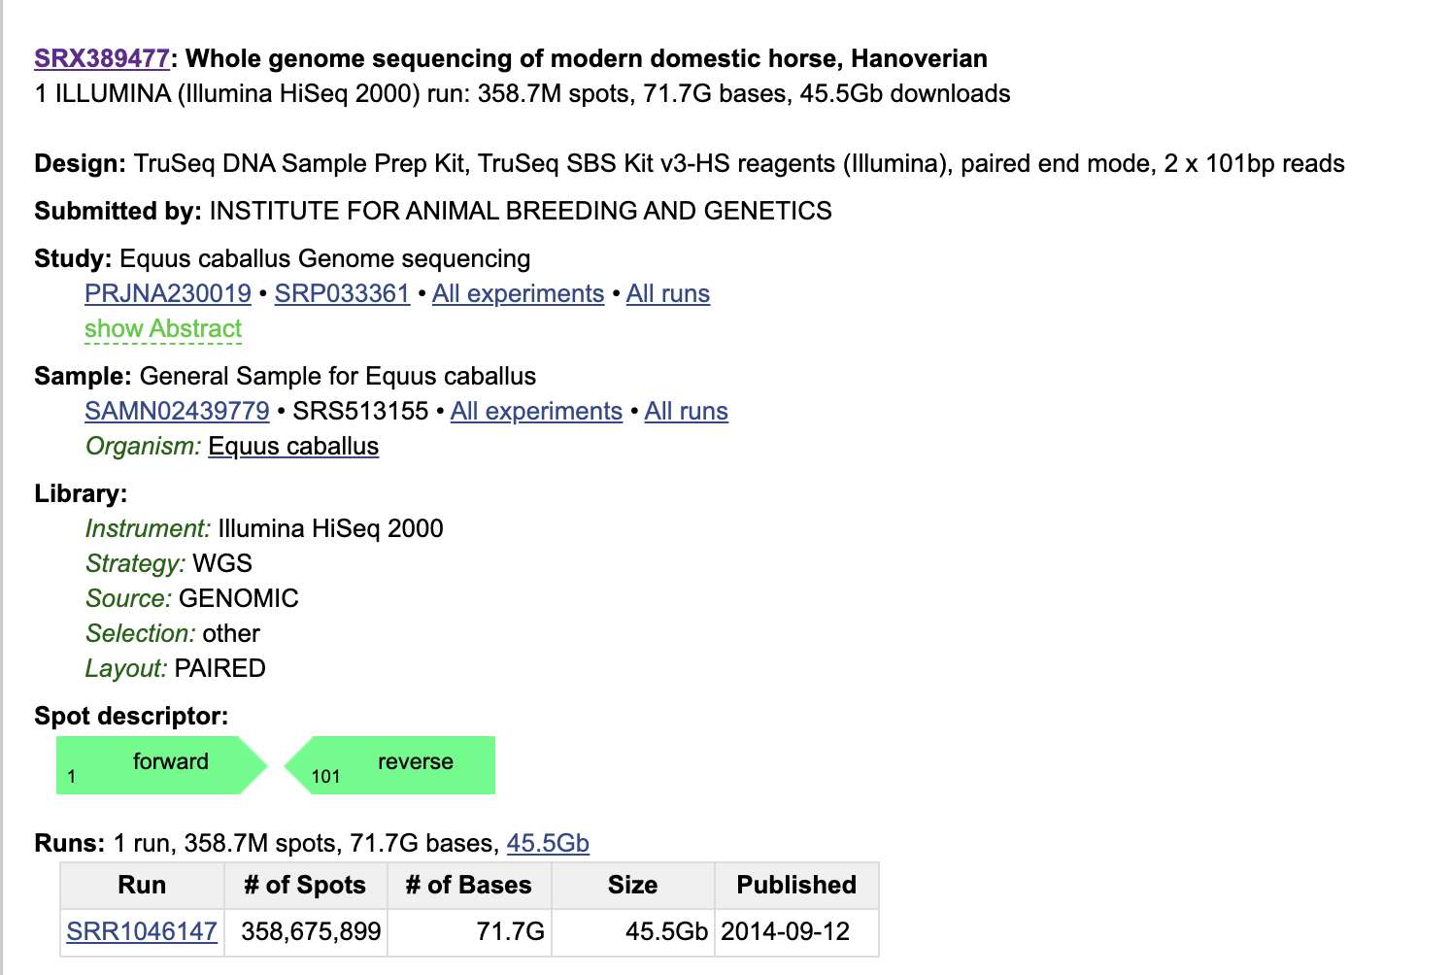
Downloading the SRA file
In your species directory use the prefetch command from SRA tools to download the file:
prefetch accession_number
prefetch SRR1046147
If you get an error due to size, use:
prefetch --verbose --force all accession_number --max-size 70G
Download can take long
Open another window and check with "htop" if still running
You can also check the directory
cd SRR1046147 (to change directory)
ls (to list contents)
If more than one file, the download was incomplete, so check again with htop and start the download again if not running anymore

Slide 14
Preprocessing
Preparing raw sequencing data for analysis
Removes low-quality reads, adapter sequences, and repeats
This can be done step by step as per GitHub instructions in
01. Getting started
02. Mapping and Variant Calling
03. Large Chromosome Selection and Consensus Building
Or in a single script

Slide 15
Preprocessing steps
FASTQ extraction from .sra files
Quality control using FastQC
Trimming poor quality regions and adapter sequences (Trimmomatic)
Aligning reads to reference genome (BWA)
Filtering variants (VCFtools, BCFtools)
Removing repeats and small scaffolds
Generating clean VCF and FASTQ files

Slide 16
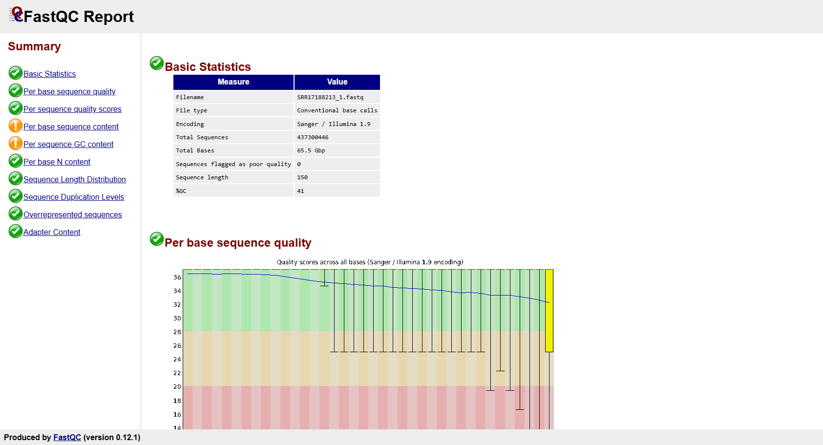
Preprocessing - FastQC
A quality control tool used to evaluate the quality of raw and processed sequencing before and after trimming or filtering.
Generates HTML file with results for each fastq file

Slide 17
Performing Preprocessing
Threads
A thread is the smallest unit of execution within a process
Multithreading allows programs to run multiple threads at the same time, usually to:
Speed up execution (e.g., parallel data processing)
Utilize multi-core CPUs efficiently
Check number of threads with "nproc" or "htop"

Slide 18
Performing Preprocessing
Copy the script "preprocessing.bash" from GitHub
Edit e.g. on Notepad++
(or on terminal with vim command)
Change thread number, working directory and bcftools path
THREADS=13
WORKING_DIR= /vol/storage/swarmgenomics/your_name
BCFTOOLS=

Slide 19
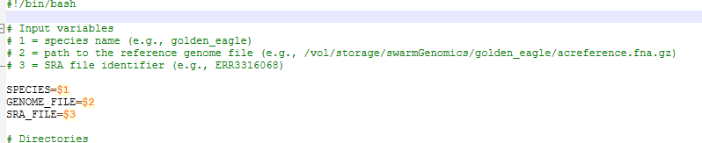
Running preprocessing.bash
Example:
nohup ./preprocessing.bash "horse" "/vol/storage/swarmgenomics/aurek/horse/GCF_900496995.4_bAquChr1.4_genomic.fna.gz" "SRR1046147" &
nohup: Runs the script so it keeps going even if you log out
&: Runs the script in the background, so the terminal stays free
"species", "genome_file", and "SRA ID") are arguments passed to the script

